Slide 1
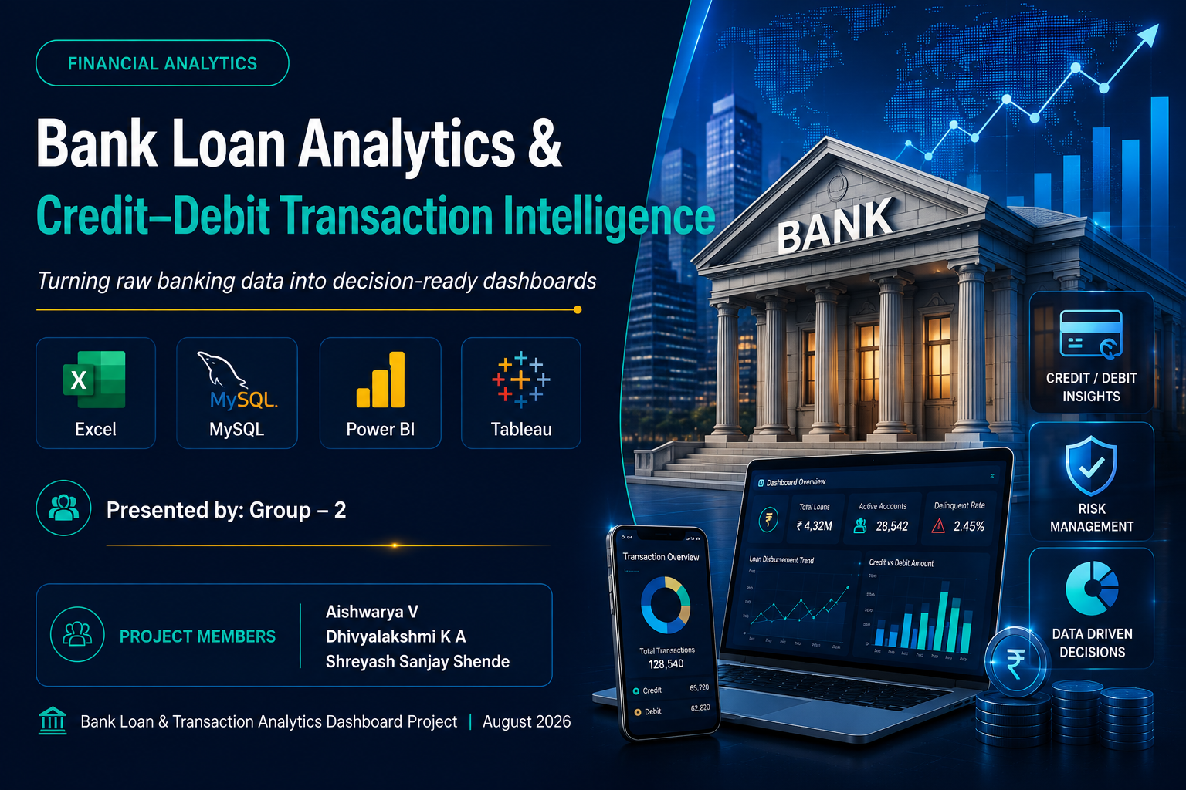

FINANCIAL ANALYTICS
Bank Loan Analytics &
Credit–Debit Transaction Intelligence
Turning raw banking data into decision-ready dashboards
Excel
MySQL
Power BI
Tableau
PROJECT MEMBERS
Presented by: Group – 2
Aishwarya V Dhivyalakshmi K A Shreyash Sanjay Shende
Bank Loan & Transaction Analytics Dashboard Project | August 2026

Slide 2
SETTING THE CONTEXT
Introduction
Banks generate enormous volumes of data every day — from loan disbursements and repayments to millions of individual credit and debit transactions. Making sense of this data is essential for sound lending decisions, fraud prevention, and long-term customer strategy.
Why This Matters
SC
Scale
Millions of transactions and tens of thousands of loans across states and branches.
This project brings together two connected datasets — a bank loan portfolio and a nationwide credit/debit transaction ledger — and turns them into a single, decision-ready analytics story using Excel, MySQL, Power BI and Tableau.
RI
Risk
Timely visibility into defaults, delinquency and high-risk transaction behaviour.
SP
Speed
Dashboards replace manual spreadsheet reporting with instant, filterable insight.
ST
Strategy
A single source of truth to guide lending, collections and fraud policy.

Slide 3
PROJECT OVERVIEW
What This Project Analyzes
01
02
03
Bank Loan Portfolio
Transaction Ecosystem
Risk & Behavior Patterns
Analysis of loan disbursements, collections, interest recovery, and default risk across states, branches and loan purposes.
Credit and debit transaction flows tracked across multiple banks, branches and transaction methods nationwide.
Identification of high-risk transactions, delinquent loans, and account activity patterns for early warning.
PROJECT OBJECTIVE
Turn raw banking data into dashboards that support lending decisions, fraud monitoring, and customer strategy.

Slide 4
PROJECT OBJECTIVES
What We Set Out To Do
Four pillars guiding the analytics workflow
01
Data Cleaning & Modelling
02
Loan Performance Analysis
Clean raw loan and transaction data, fix nulls, standardize formats, and build fact-dimension relationships.
Analyze disbursements, collections, interest recovery, and default/delinquency trends across regions.
03
Transaction Risk Monitoring
04
Interactive Dashboards
Track credit/debit volumes by bank and branch, and flag high-risk transaction behavior.
Build dynamic Excel, Power BI and Tableau dashboards with KPI tiles, slicers and drill-downs.

Slide 5
METHODOLOGY
Tools & Technologies Used
End-to-end BI stack for this project
Microsoft Excel
MySQL
Tableau
Power BI
Data Cleaning
Data Storage
KPI Cards
DAX Measures
Pivot Tables
Joins across tables
Line & bar charts
Drill-through
VLOOKUP / IF
GROUP BY aggregation
Maps by region
KPI tiles
Charts & KPI cards
Business queries
Interactive filters
Slicers & parameters

Slide 6
PROCESS
Project Workflow
End-to-end pipeline from raw data to business insight
1
2
3
4
5
6
Raw Data
Excel Cleaning
MySQL Database
Tableau Dashboard
Power BI Dashboard
Business Insights
Loan & transaction worksheets
Remove errors, standardize
Import tables, run joins
Interactive visuals & maps
KPI tiles, DAX & slicers
Recommendations & decisions

Slide 7
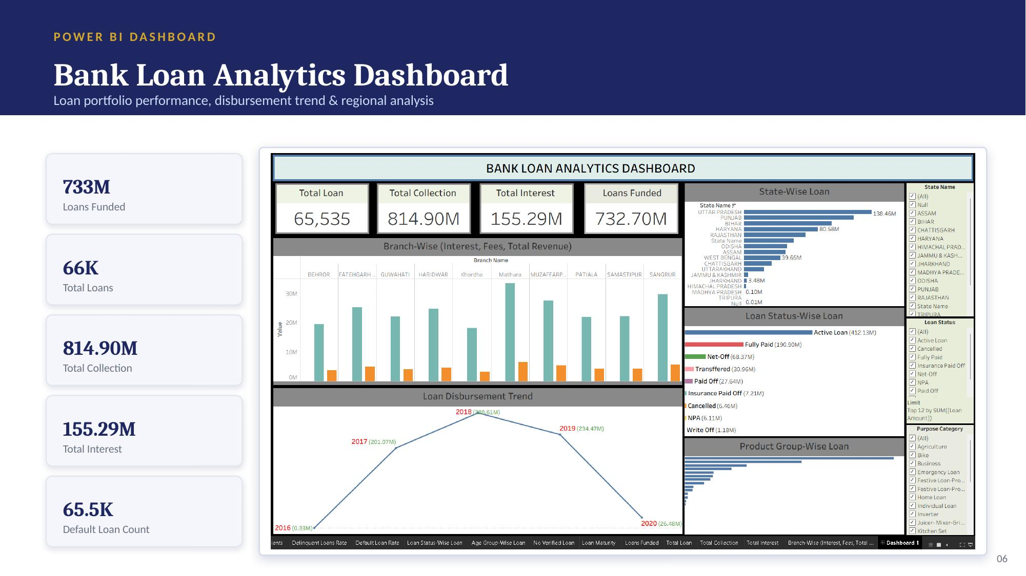

Slide 8
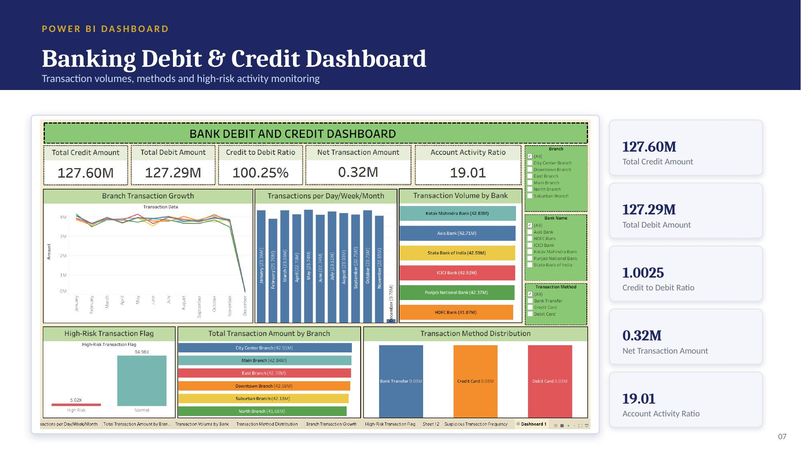

Slide 9
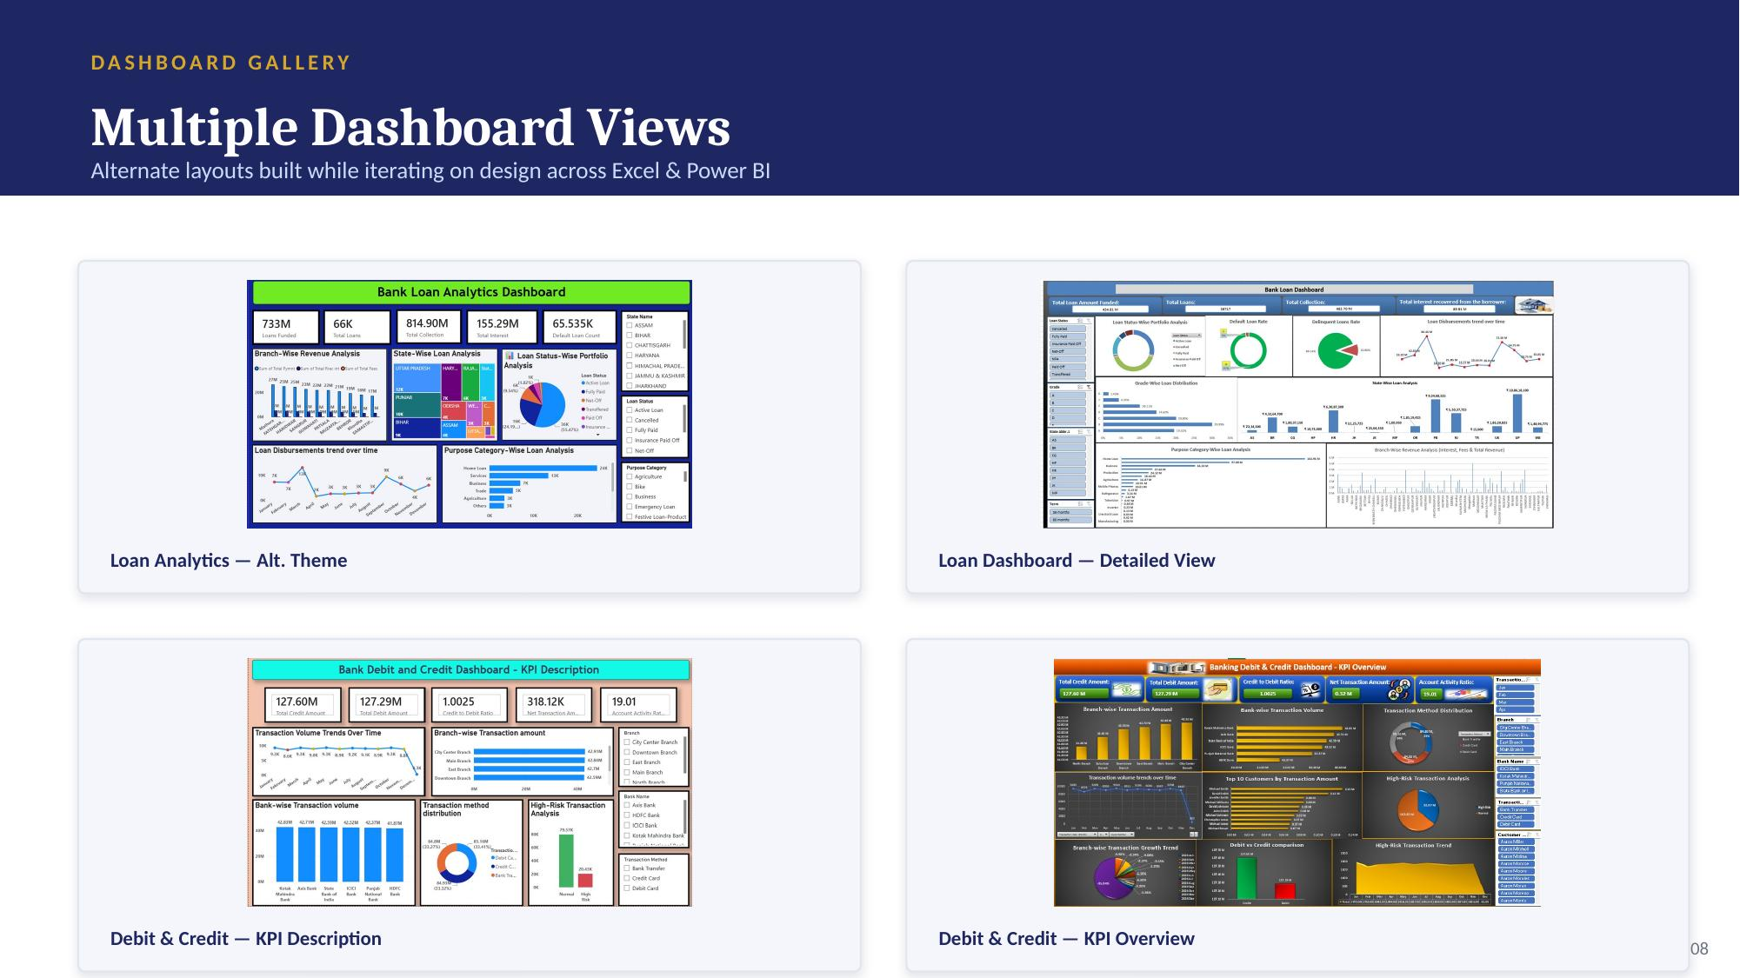

Slide 10
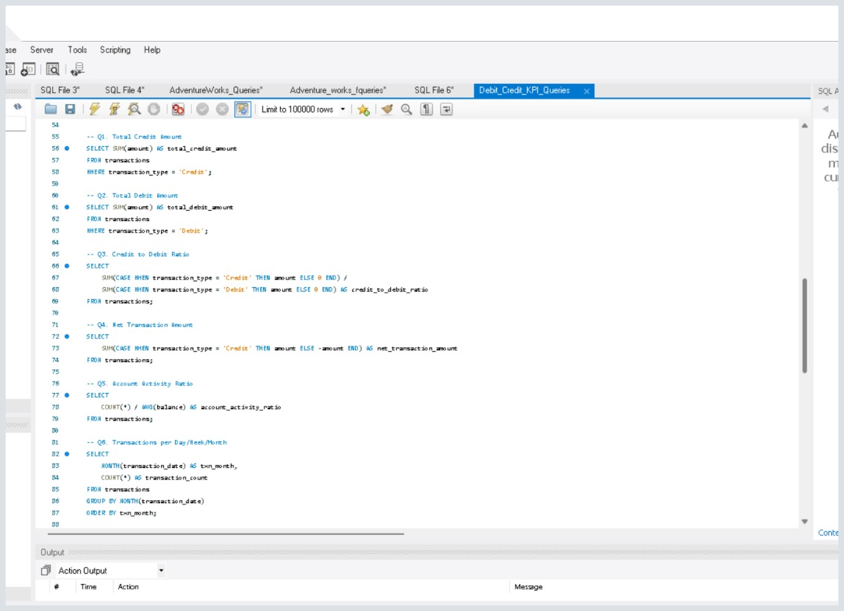
SQL ANALYSIS
Evidence from the project SQL workbench
From business questions to measurable results
MySQL queries used to validate the dashboard KPIs, segment transaction behaviour, and quantify loan risk.
Question
→
SQL Query
→
Result
→
Business Use
Transaction KPI queries
Credit • Debit • Ratio • Activity • Risk
10

Slide 11
SQL ANALYSIS
Transaction KPIs
Core measures used in the debit & credit dashboard
1
Total Credit Amount
2
Total Debit Amount
Sum of transaction amounts where type = Credit.
Sum of transaction amounts where type = Debit.
SQL
SQL
SELECT SUM(amount) AS total_credit_amount
FROM transactions
WHERE transaction_type = 'Credit';
SELECT SUM(amount) AS total_debit_amount
FROM transactions
WHERE transaction_type = 'Debit';
KEY OUTPUT
KEY OUTPUT
127.60M
127.29M
3
Credit-to-Debit Ratio
Compares total credit value with total debit value.
SQL
SELECT
SUM(CASE WHEN transaction_type='Credit' THEN amount ELSE 0 END) /
SUM(CASE WHEN transaction_type='Debit' THEN amount ELSE 0 END)
AS credit_to_debit_ratio
FROM transactions;
KEY OUTPUT
1.0025
11

Slide 12
SQL ANALYSIS
Transaction behaviour metrics
Net movement, account activity and transaction frequency
4
Net Transaction Amount
5
Account Activity Ratio
Credits are positive; debits are subtracted.
Transaction count divided by average balance.
SQL
SQL
SELECT SUM(
CASE WHEN transaction_type='Credit' THEN amount
ELSE -amount END
) AS net_transaction_amount
FROM transactions;
SELECT COUNT(*) / AVG(balance) AS account_activity_ratio
FROM transactions;
KEY OUTPUT
KEY OUTPUT
0.32M
19.01
6
Transactions by Month
Groups transaction records by month and counts rows.
SQL
SELECT MONTH(transaction_date) AS txn_month,
COUNT(*) AS transaction_count
FROM transactions
GROUP BY MONTH(transaction_date)
ORDER BY txn_month;
KEY OUTPUT
Monthly counts
12

Slide 13
SQL ANALYSIS
Branch, bank & method analysis
Breaking transaction value and usage into operational dimensions
7
Total Transaction Amount by Branch
8
Transaction Volume by Bank
Ranks branches by total transaction value.
Ranks banks by total transaction amount.
SQL
SQL
SELECT branch, SUM(amount) AS total_amount
FROM transactions
GROUP BY branch
ORDER BY total_amount DESC;
SELECT bank_name, SUM(amount) AS total_volume
FROM transactions
GROUP BY bank_name
ORDER BY total_volume DESC;
KEY OUTPUT
KEY OUTPUT
Branch ranking
42.83M
9
Transaction Method Distribution
Counts methods and calculates each method’s share.
SQL
SELECT transaction_method,
COUNT(*) AS transaction_count,
COUNT(*) * 100.0 /
(SELECT COUNT(*) FROM transactions) AS percentage
FROM transactions
GROUP BY transaction_method;
KEY OUTPUT
≈ 1/3 each
13

Slide 14
SQL ANALYSIS
Branch transaction growth
Comparing first-half and second-half transaction value by branch
Q10
Q10
SQL
WHAT IT CALCULATES
SELECT branch,
SUM(CASE WHEN MONTH(transaction_date)<=6 THEN amount ELSE 0 END) AS h1_amount,
SUM(CASE WHEN MONTH(transaction_date)>=7 THEN amount ELSE 0 END) AS h2_amount,
ROUND((SUM(CASE WHEN MONTH(transaction_date)>=7 THEN amount ELSE 0 END)
- SUM(CASE WHEN MONTH(transaction_date)<=6 THEN amount ELSE 0 END))
/ SUM(CASE WHEN MONTH(transaction_date)<=6 THEN amount ELSE 0 END) * 100, 2) AS growth_percent
FROM transactions
GROUP BY branch;
Branch-level H1 amount, H2 amount and growth %.
Growth %
(H2 − H1) / H1 × 100
The query returns one row per branch, making it suitable for branch comparison and trend review.
No single numeric output is shown in the supplied screenshot; the query defines the calculation.
14
14

Slide 15
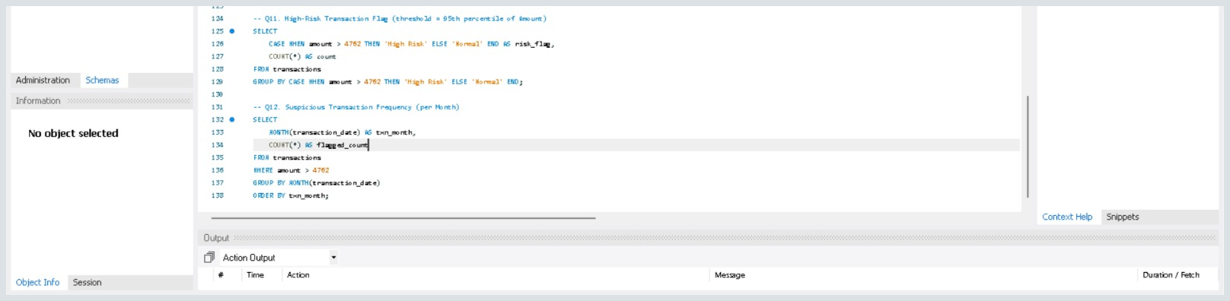
SQL ANALYSIS
Risk monitoring queries
Large-value transaction flags and monthly suspicious-frequency tracking
11
High-Risk Transaction Flag
12
Suspicious Transaction Frequency
Uses the project threshold rule to classify unusually large transactions.
Counts flagged transactions by month for frequency monitoring.
SQL
SQL
SELECT CASE WHEN amount > 4762 THEN 'High Risk' ELSE 'Normal' END AS risk_flag,
COUNT(*) AS count
FROM transactions
GROUP BY CASE WHEN amount > 4762 THEN 'High Risk' ELSE 'Normal' END;
SELECT MONTH(transaction_date) AS txn_month,
COUNT(*) AS flagged_count
FROM transactions
WHERE amount > 4762
GROUP BY MONTH(transaction_date)
ORDER BY txn_month;
KEY OUTPUT
KEY OUTPUT
> 4,762
Monthly flagged count
MySQL Workbench evidence supplied with the project
15
15

Slide 16
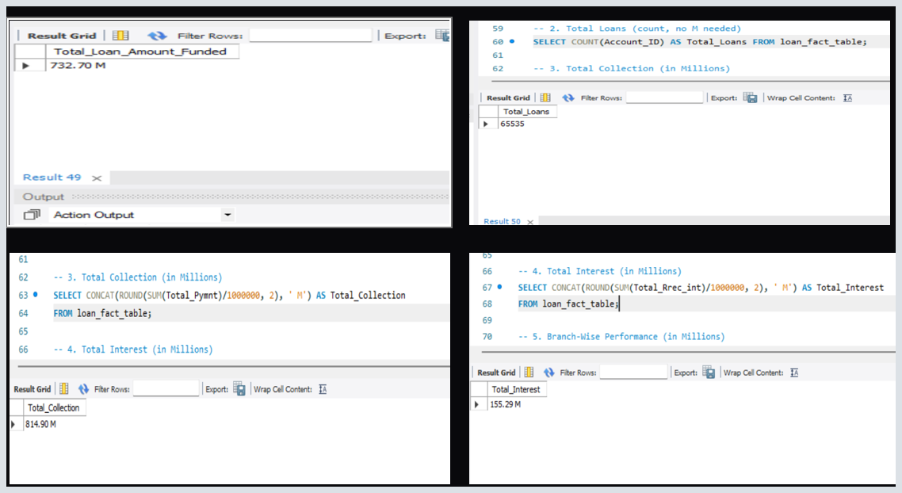
SQL ANALYSIS
Loan portfolio SQL results
Selected loan queries with the outputs visible in the supplied MySQL results
LOANS FUNDED
TOTAL LOANS
TOTAL COLLECTION
TOTAL INTEREST
732.70M
65,535
814.90M
155.29M
Total_Loan_Amount_Funded
COUNT(Account_ID)
SUM(Total_Pymnt)
SUM(Total_Rrec_int)
SELECTED LOAN QUERIES
-- Total Loans
SELECT COUNT(Account_ID) AS Total_Loans
FROM loan_fact_table;
-- Total Collection (in Millions)
SELECT CONCAT(ROUND(SUM(Total_Pymnt)/1000000,2),' M')
AS Total_Collection FROM loan_fact_table;
-- Total Interest (in Millions)
SELECT CONCAT(ROUND(SUM(Total_Rrec_int)/1000000,2),' M')
AS Total_Interest FROM loan_fact_table;
The displayed outputs are taken from the supplied MySQL result grids.
16

Slide 17
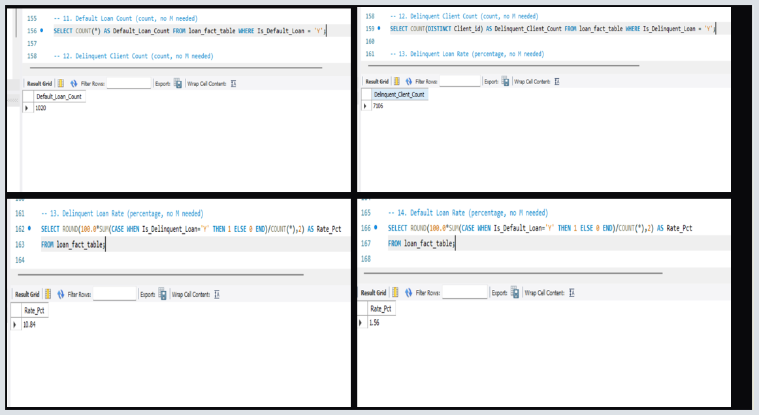
SQL ANALYSIS
Loan risk metrics
Default and delinquency queries used to quantify portfolio risk
DEFAULT LOAN COUNT
DELINQUENT CLIENT COUNT
DELINQUENT LOAN RATE
DEFAULT LOAN RATE
1,020
7,106
10.84%
1.56%
WHERE Is_Default_Loan = Y
COUNT(DISTINCT Client_ID)
share of delinquent loans
share of default loans
RISK QUERIES
-- Default Loan Count
SELECT COUNT(*) AS Default_Loan_Count
FROM loan_fact_table WHERE Is_Default_Loan = 'Y';
-- Delinquent Client Count
SELECT COUNT(DISTINCT Client_ID) AS Delinquent_Client_Count
FROM loan_fact_table WHERE Is_Delinquent = 'Y';
-- Delinquent Loan Rate
SELECT ROUND(100.0 *
SUM(CASE WHEN Is_Delinquent='Y' THEN 1 ELSE 0 END) / COUNT(*), 2)
AS Rate_Pct FROM loan_fact_table;
-- Default Loan Rate
SELECT ROUND(100.0 *
SUM(CASE WHEN Is_Default_Loan='Y' THEN 1 ELSE 0 END) / COUNT(*), 2)
AS Rate_Pct FROM loan_fact_table;
These values are the visible outputs from the supplied SQL screenshots.
17

Slide 18
LIVE DATA HIGHLIGHTS
Loan Portfolio Snapshot
Key figures rebuilt as native charts for at-a-glance reading
733M
66K
814.90M
155.29M
Loans Funded
Total Loans
Total Collection
Total Interest
Loan Status Mix (₹M)
Branch-Wise Total Revenue (₹M, top 5)
Illustrative ranking based on the branch revenue chart in the source dashboard.

Slide 19
LIVE DATA HIGHLIGHTS
Transaction Intelligence Snapshot
Credit, debit and bank-level activity rebuilt as native charts
127.60M
127.29M
1.0025
19.01
Total Credit
Total Debit
Credit/Debit Ratio
Account Activity Ratio
Transaction Volume by Bank (₹M)
Credit vs Debit (₹M)
Transaction Method Split

Slide 20
KEY BUSINESS INSIGHTS
What the Loan Data Revealed
Portfolio composition, regional concentration and risk signals
●
Uttar Pradesh Leads Lending
●
Active Loans Dominate
With loans exceeding ₹138M, Uttar Pradesh is the top-performing state, followed by Punjab and Bihar.
Active Loans make up over 55% of the total loan status mix, with Fully Paid and Net-Off loans forming the remainder.
●
Home Loans Drive Volume
●
Default Risk Is Contained
Home Loan is the leading purpose category by disbursed amount, well ahead of Business and Services loans.
Default and delinquent loans represent a small single-digit share of the book, indicating healthy overall credit quality.

Slide 21
KEY BUSINESS INSIGHTS
What the Transaction Data Revealed
Bank, branch and method-level patterns in credit & debit activity
●
Credit & Debit Nearly Balanced
●
Kotak Mahindra Bank Leads
Total credit (127.60M) and debit (127.29M) volumes are almost equal, giving a credit-to-debit ratio close to 1.0.
Kotak Mahindra Bank tops transaction volume at 42.83M, closely followed by Axis Bank and State Bank of India.
●
Even Spread Across Methods
●
High-Risk Activity Flagged
Bank Transfer, Credit Card and Debit Card each account for roughly a third of transaction method usage.
A distinct high-risk transaction segment (~20K) is isolated from normal activity, enabling focused fraud monitoring.

Slide 22
RECOMMENDATIONS
Strategic Recommendations
Actionable next steps derived from data insights
01
Strengthen High-Priority States
Focus lending capacity and staff in Uttar Pradesh, Punjab and Bihar where loan demand is highest.
02
Automate Risk Flagging
Operationalize the high-risk transaction model to trigger real-time alerts for suspicious activity.
03
Grow Home Loan Cross-Sell
Bundle insurance and related products with Home Loans, the largest purpose category by volume.
04
Balance Channel Load
Use the even Bank Transfer / Credit / Debit split to plan capacity across payment infrastructure.
05
Targeted Collections Focus
Prioritize collections effort on the small pool of default/delinquent accounts to protect asset quality.

Slide 23
RETROSPECTIVE
Challenges & How We Overcame Them
Obstacles encountered and the approach taken to resolve each one
Challenge
Why It Was Hard
How We Overcame It
Data Cleaning Complexity
Inconsistent date formats, duplicate records and null values.
Standardized formats and de-duplicated records in Excel before loading.
Relationship Modelling
Accurate Fact-Dimension relationships needed in Power BI.
Careful key mapping and validation between loan and transaction tables.
Complex SQL Joins
Multi-table joins across loan and transaction tables.
Iterative query refinement and testing in MySQL Workbench.
Dashboard Design
Clean, non-cluttered layouts across Tableau and Power BI.
Adopted a consistent color system and simplified chart choices.
DAX Time Intelligence
YoY and cumulative measures needed strong DAX filter context.
Built and validated measures incrementally against known totals.
Risk Threshold Calibration
Setting thresholds without excessive false positives.
Used the 95th-percentile amount rule, tuned against sample data.

Slide 24
WHAT'S NEXT
Future Scope
Where this project can evolve next
01
02
03
04
AI Sales & Default Forecasting
Customer Risk Prediction
Real-Time Dashboards
Automated Fraud Alerts
Use machine learning to predict future loan defaults and transaction risk trends.
Build a classification model identifying at-risk borrowers and accounts before issues emerge.
Connect dashboards to live data feeds for real-time loan and transaction monitoring.
Integrate high-risk transaction scoring with automated notification workflows.

Slide 25
VALUE DELIVERED
Advantages
Benefits realized through this analytics initiative
✓
Faster, Data-Driven Decisions
✓
Early Risk Detection
Interactive dashboards replace manual reporting, giving stakeholders instant access to loan and transaction KPIs.
High-risk transaction flags and delinquency tracking surface problems before they escalate.
✓
Unified View Across Sources
✓
Regional & Branch Visibility
MySQL joins bring loan and transaction data together into one consistent, queryable model.
State, branch and bank-level breakdowns highlight where lending demand and risk are concentrated.
✓
Self-Service Exploration
✓
Scalable Foundation
Slicers, filters and drill-throughs let business users answer their own questions without new reports.
The Excel → MySQL → BI pipeline can absorb new data sources as the bank's footprint grows.

Slide 26
LIMITATIONS & CONSTRAINTS
Disadvantages
Trade-offs and constraints to keep in mind
!
Static Data Snapshots
!
Manual Cleaning Effort
Dashboards refresh on import rather than live feeds, so figures can lag real-world activity.
Inconsistent formats and nulls in source files still require significant hands-on preprocessing.
!
Threshold Sensitivity
!
Tool Fragmentation
High-risk flags depend on fixed percentile cut-offs, which can misclassify borderline transactions.
Logic is spread across Excel, MySQL, Tableau and Power BI, increasing maintenance overhead.
!
Limited Predictive Power
!
Scalability Ceiling
Current dashboards are descriptive; they do not yet forecast future defaults or fraud.
Very large data volumes may require a more robust warehouse than the current MySQL setup.

Slide 27
WRAP-UP
Conclusion
✓
Data Pipeline Complete:
Extracted, cleaned, and modelled loan and transaction data through Excel and MySQL.
✓
Dashboards Built:
Delivered interactive Tableau and Power BI dashboards with filters, KPIs, and drill-downs.
✓
Insights Generated:
Identified key drivers: UP/Punjab lending demand, Home Loan volume, and balanced transaction channels.
✓
Risk Visibility Established:
Isolated high-risk transactions and default accounts for focused monitoring.
✓
Recommendations Delivered:
Provided five strategic recommendations covering lending, risk, cross-sell, and collections.
This project shows how a disciplined Excel → MySQL → BI pipeline can convert raw banking records into a single, trustworthy view of lending performance and transaction risk — giving the business the clarity it needs to lend confidently, act early on risk, and grow the right products in the right regions.

Slide 28

Thank You
Questions & Discussion
Bank Loan & Transaction Analytics Dashboard Project | August 2026

